Slide 1
CS 6323: Computer Animation & Gaming
Fall 2020

Slide 2
Instructor & TA
Instructor: Prof. Xiaohu Guo
Class Time: M/W 4:00pm – 5:15pm
Classes will be delivered on MS Teams
Recorded Videos will be on MS Stream
Instructor Email: xguo@utdallas.edu
Instructor Office Hours: Tu/W 10:00am – 11:00am
Instructor Office Hours will be on MS Teams
TA: Chenxu Zhang ( TA Email: chenxu.zhang@utdallas.edu )
TA Office Hours: F 8:00pm – 10:00pm
TA Office Hours will be on MS Teams

Slide 3
Prerequisites
CS5343, Algorithm Analysis and Data Structure
Familiar with:
Vectors (dot products, cross products…)
Matrices (4x4 homogeneous transformations)
Linear Algebra
C++ (will use OpenGL)

Slide 4
Course Goals
OpenGL Programming
Vector/Matrix
Cubic Curves
Channels & Keyframes
Animation Blending
Quaternions
Skeletons
Skinning
Inverse Kinematics
Particle Systems
Rigid Body Physics
Collision Detection

Slide 5
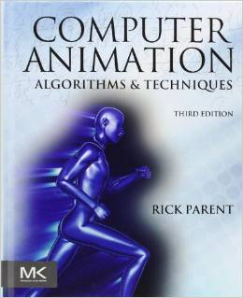
Required Book
“Computer Animation: Algorithms and Techniques”. Author: Rick Parent, Published by Morgan Kaufmann, 3rd Edition, 2012, ISBN: 0124158420.

Slide 6

Suggested Reference Book
“OpenGL Programming Guide: The Official Guide to Learning OpenGL, Version 4.3 (8th Edition)”. Published by Addison Wesley, 2013, ISBN: 0321773039. (OpenGL “Redbook”)

Slide 7
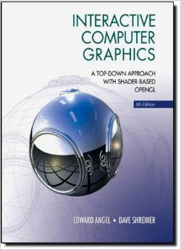
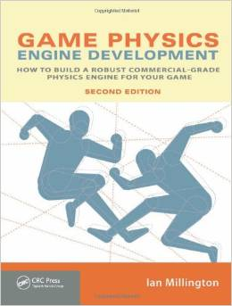
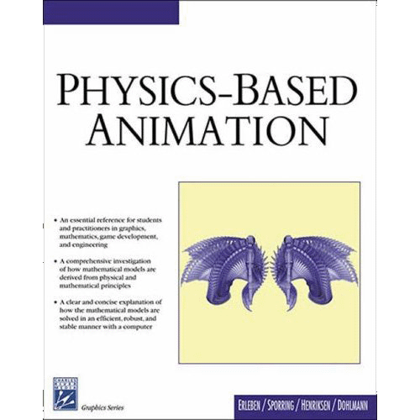
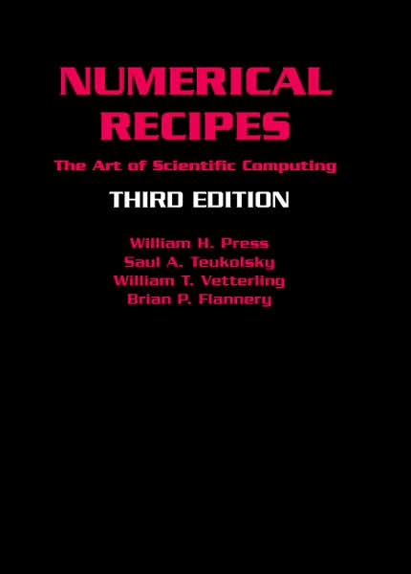
Other Related Reference Books
“Interactive Computer Graphics: A Top-Down Approach with Shader-Based OpenGL”. Author: Edward Angel, Published by Addison Wesley, 6th Edition, 2011, ISBN: 0132545233.
“Game Physics Engine Development: How to Build a Robust Commercial-Grade Physics Engine for your Game”. Author: Ian Millington, Published by CRC Press, 2nd Edition, 2010, ISBN: 0123819768.
“Physics-Based Animation”. Authors: Kenny Erleben, Jon Sporring, Knud Henriksen, and Henrik Dohlmann, Published by Charles River Media, 2005, ISBN: 1584503807.
“Numerical Recipes: The Art of Scientific Computing”. Authors: William H. Press, Saul A. Teukolsky, William T. Vetterling, Brian P. Flannery, Published by Cambridge University Press, 3rd Edition, 2007, ISBN: 0521880688.

Slide 8
Grading
Programming Assignments – 65%
Assignment 0: 3%
Assignment 1: 10%
Assignment 2: 10%
Assignment 3: 10%
Assignment 4: 10%
Assignment 5: 10%
Assignment 6: 12%
Final Project – 30%
Project Proposal 5%
Project Demo, Presentation, Report 25%
Class Attendance – 5%

Slide 9
Academic Honesty
If you use an external resource cite it clearly!
Don’t do things that would be considered dishonest... if in doubt ask.
Cheating earns you:
An ‘F’ in the class and
Getting reported to the University
No exceptions.

Slide 10
Computer Animation Overview

Slide 11
Applications
Special Effects (Movies, TV)
Video Games
Virtual Reality
Simulation, Training, Military
Medical
Robotics
Visualization

Slide 12
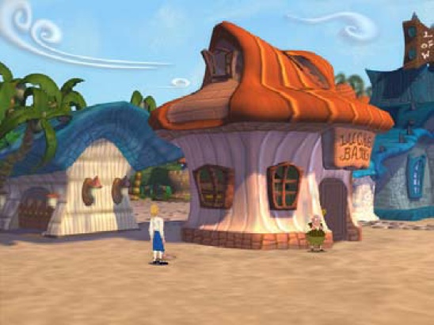
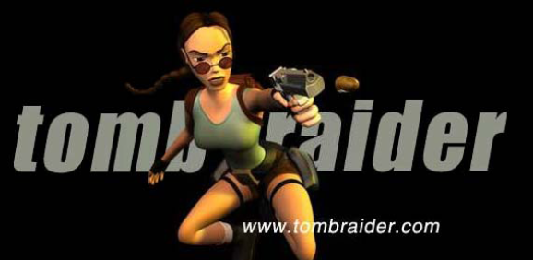
Entertainment Industry: Game
High demand entertainment industry
Character Animation
Skeleton & Joints

Slide 13
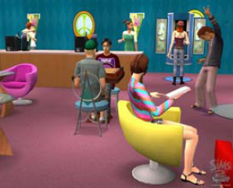
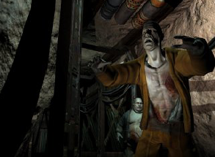
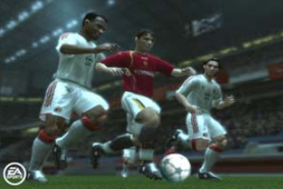
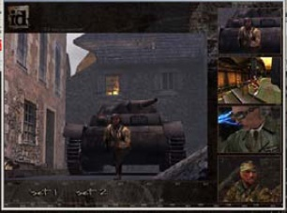
Better Hardware
The lines between games and movies continue to be blurred

Slide 14
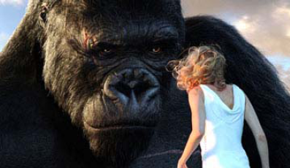

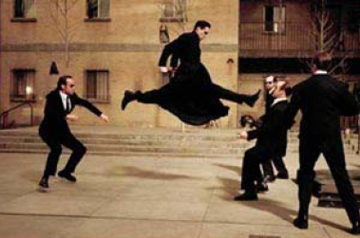
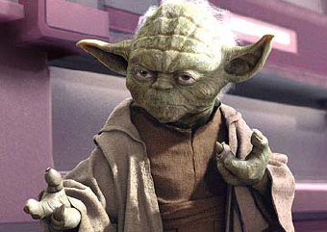
Entertainment Industry: Movie
Magic of Computer Graphics and Animation in movie industry

Slide 15

Animation Movies

Slide 16
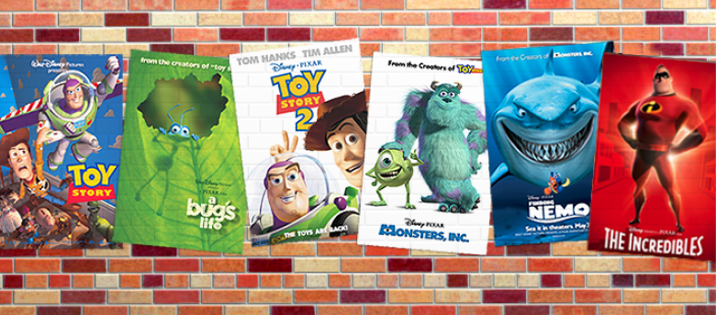
Animation Movies

Slide 17
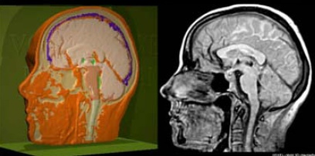
Visualization: Visible Human Project
Medical imaging & visualization

Slide 18
Medical Imaging: Tumor Segmentation

Slide 19
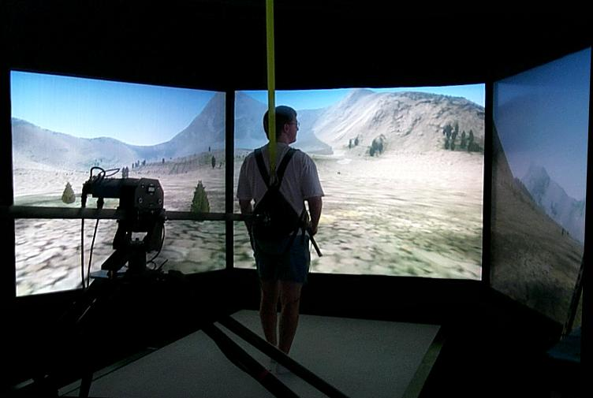
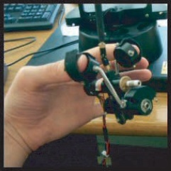
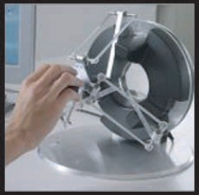
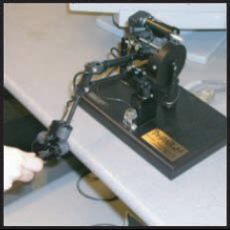
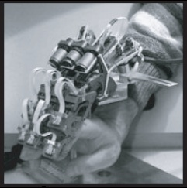
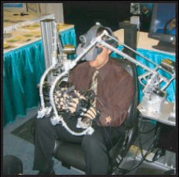
Virtual Reality
User interacts with objects in a 3D scene
Special devices (input, output)
Virtual walkthroughs
Equipment training (pilots, surgeons, etc.)
_{Force reflecting gripper}
_{Haptic devices}
_{Force feedback exoskeleton}
_{Haptic workstation}

Slide 20
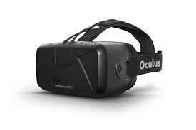
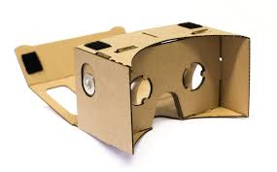
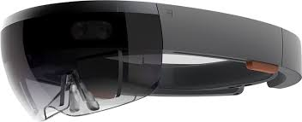
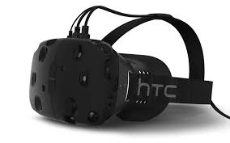
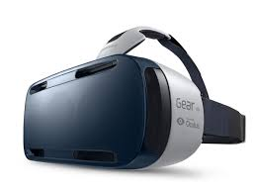
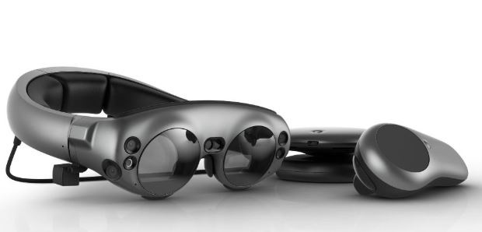
VR/AR HMD (Head Mounted Display)

Slide 21
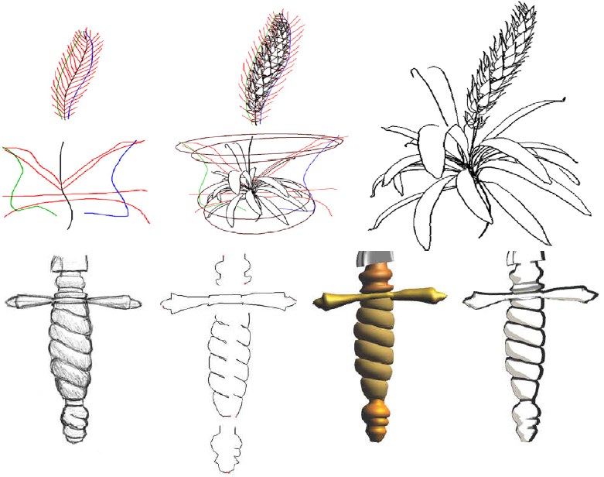
Computer Art
Sketch-Based Modeling & Non-Photorealistic Rendering

Slide 22
Computer Art

Slide 23
Computer Animation
Kinematics
Physics (a.k.a. dynamics, simulation, mechanics)
Character animation
Motion capture / data driven animation

Slide 24
Animation Process
while (not finished) {
MoveEverything();
DrawEverything();
}
Interactive vs. Non-Interactive
Real Time vs. Non-Real Time

Slide 25
Character Rigging
Skeleton
Skin
Facial Expressions
Muscles
Secondary motion: fat, hair, clothing…

Slide 26
Character Animation
Keyframe Animation
Motion Capture
Inverse Kinematics

Slide 27
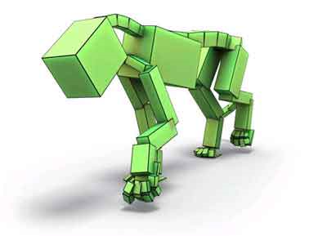
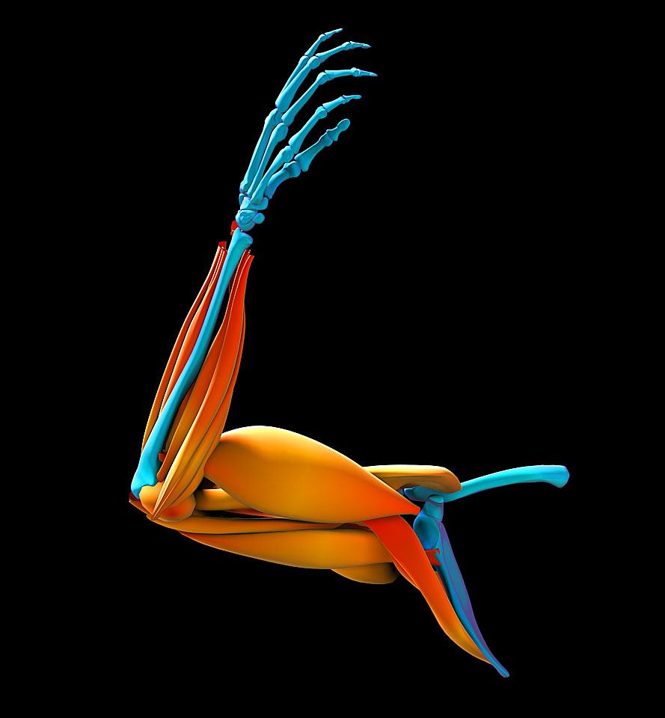
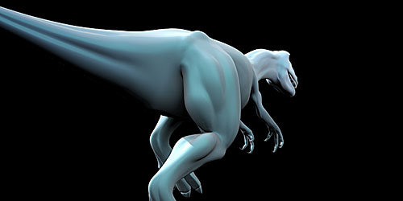
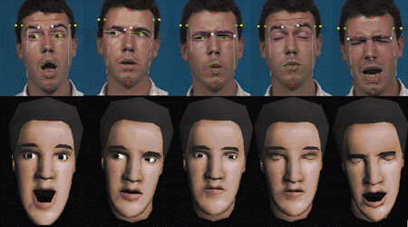
Character Animation

Slide 28
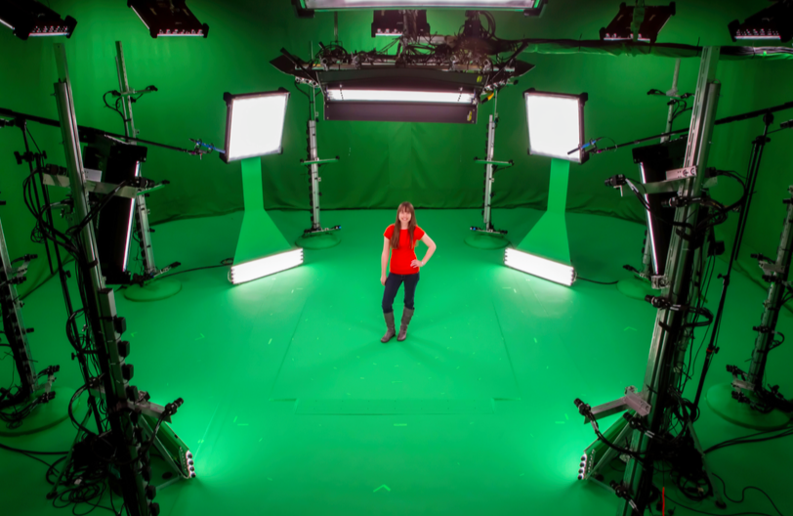
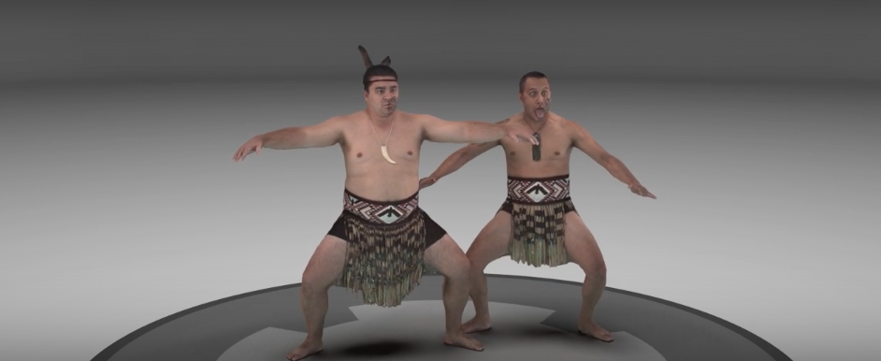
Offline, Multi-view, Dynamic 3D Reconstruction
High-quality streamable free-viewpoint video, SIGGRAPH 2015
Microsoft: MR Capture Studios (Metastages licensed to Hollywood production companies)
Notes:
In computer vision and computer graphics, people have been working on 3D scene reconstruction, from multiple cameras. Reconstructing static scene, such as the indoor or outdoor buildings, etc. has become no surprise. But for reconstructing dynamic human body and motion, it is always been a huge challenge. One of the most notable work is in 2015, researchers from MSR proposed the so-called “streamable free-viewpoint video”, which is actually a sequentially reconstructed dynamic 3D scene representation. It captures the scene with 106 synchronized RGB and IR cameras on a calibrated green-screen stage. It is also offline computation, takes about half minute to process each frame.

Slide 29
SIGGRAPH 2015

Slide 30
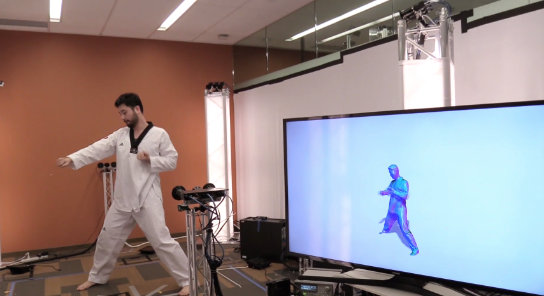
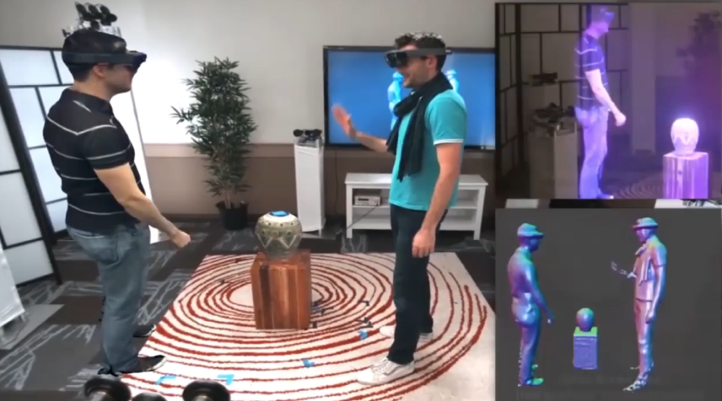
Real-time, Multi-view, Dynamic 3D Reconstruction
Fusion4D
[SIGGRAPH 2016]
Holoportation
[UIST 2016]
Notes:
In 2016, researchers from MSR proposed a real-time multi-view dynamic reconstruction system called Fusion4D, using a set of 24 cameras producing 8 depthmaps and RGB images at the same time. Based on that, a Holoportation system is proposed, where users from geographically distributed spaces, and wearing Hololens can interact with each other in the same virtual space seemlessly. Very impressive system! But it still uses 24 cameras and 9 PCs to compute.

Slide 31
Fusion4D, SIGGRAPH 2016

Slide 32
Holoportation, UIST 2016

Slide 33
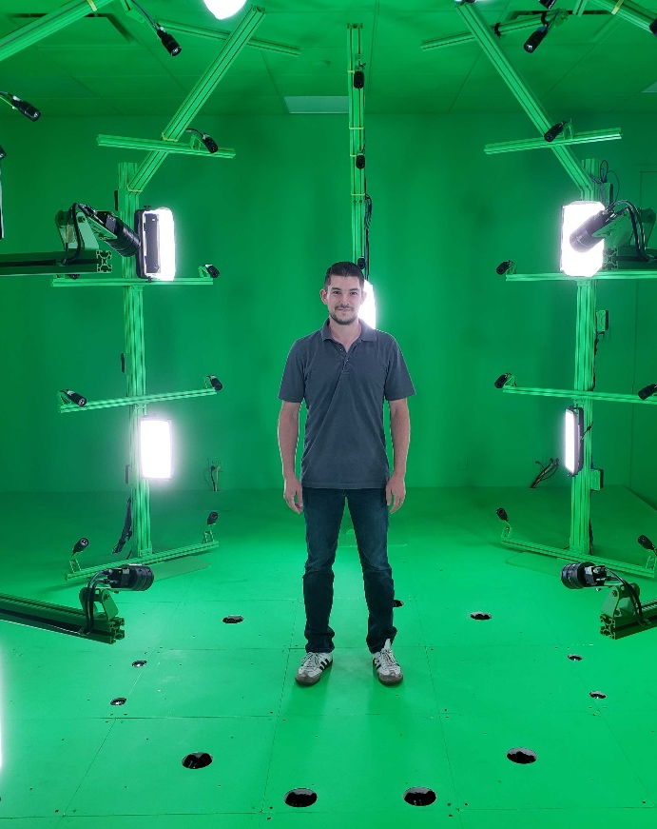
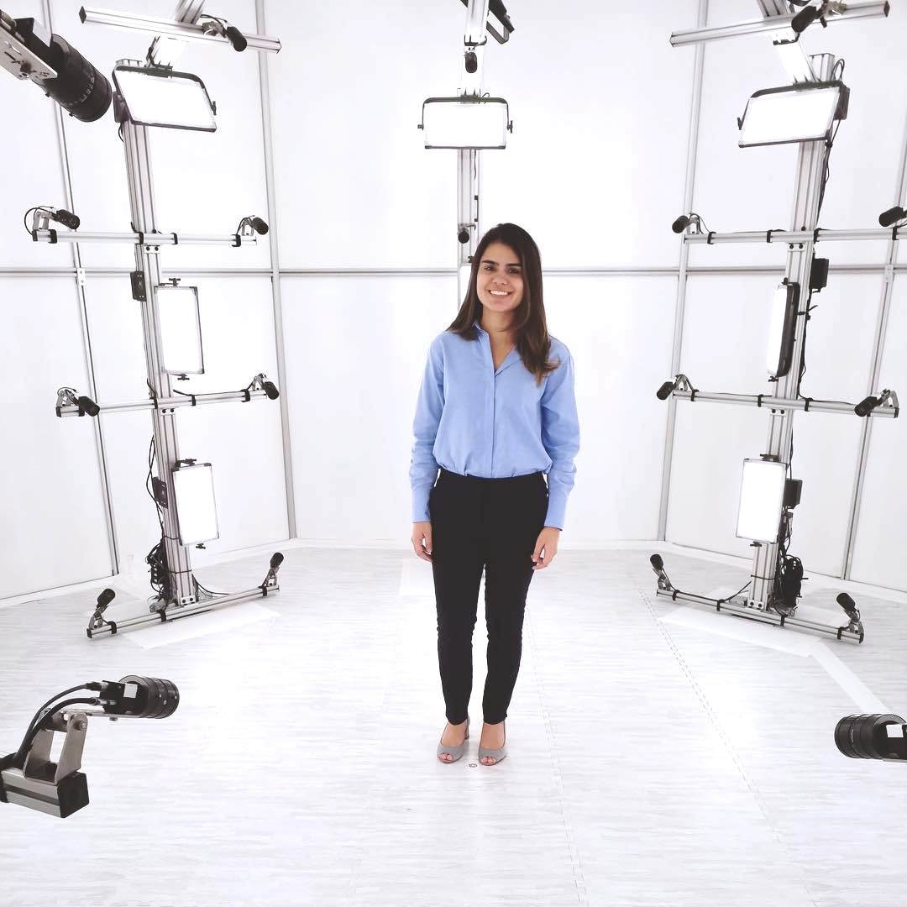
Samsung XR Studio
Currently, there are 2 Samsung XR Capture Studios located in Samsung Offices
Dallas, Texas
Mountain View, California
SAMSUNG | ON THE BAY SMPTE & AIS

Slide 34
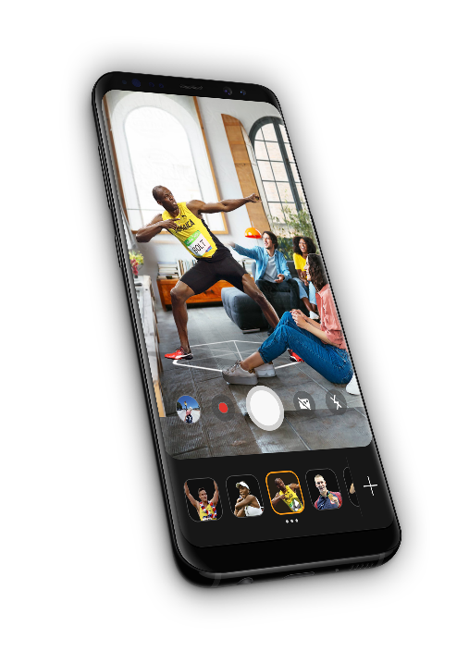


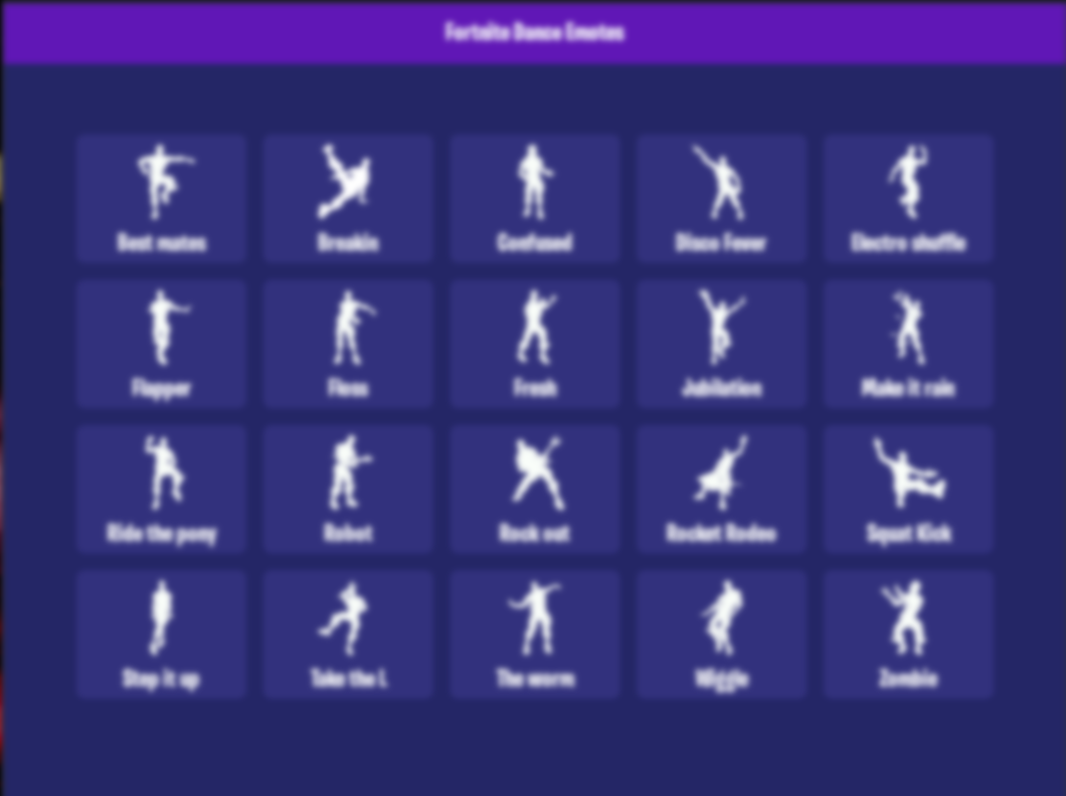
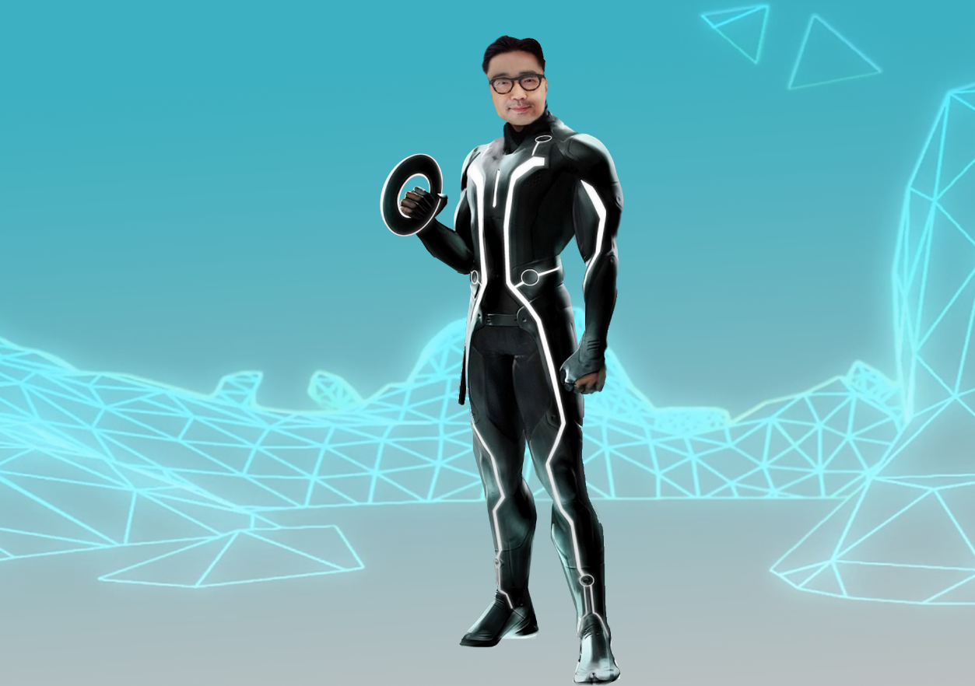
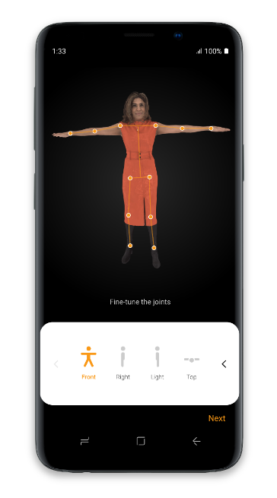

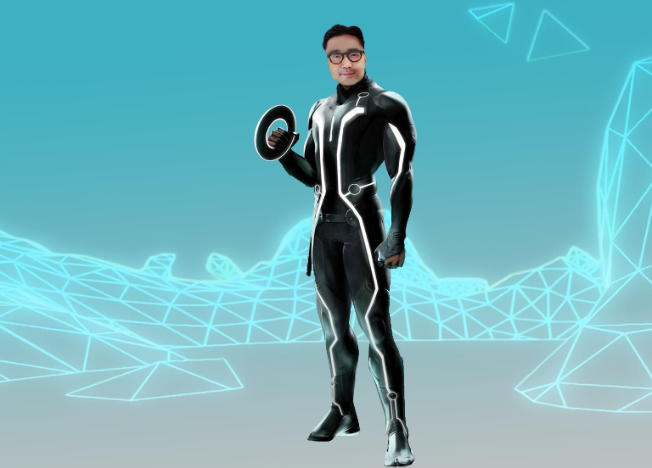
Samsung XR
Volumetric Content use cases
Pose with branded content
Interact with celebrities in your home
Create your emotes like Fortnite dances
Be your favorite character

Slide 35
3D Virtual Assistant

Slide 36
Physics Simulation
Particles
Rigid bodies
Collisions, contact, stacking, rolling, sliding
Articulated bodies
Hinges, constraints
Deformable bodies (solid mechanics)
Elasticity, plasticity, viscosity
Fracture
Cloth
Fluid dynamics
Fluid flow (liquids & gasses)
Combustion (fire, smoke, explosions…)
Phase changes (melting, freezing, boiling…)
Vehicle dynamics
Cars, boats, airplanes, helicopters, motorcycles…
Character dynamics
Body motion, skin & muscle, hair, clothing

Slide 37
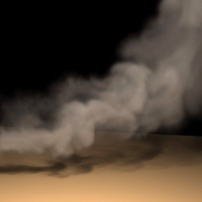
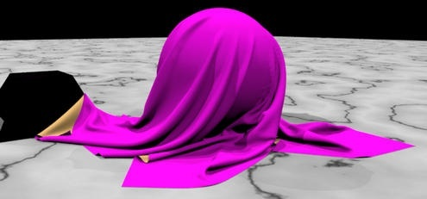

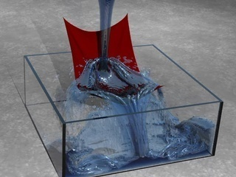
Physics Simulation

Slide 38
Animation Tools
Maya
3D Max Studio
Blender
Mixamo
Many more…

Slide 39
Rendering
There are many ways to design a 3D renderer
The two most common approaches are:
Traditional graphics pipeline
Ray-based rendering
With the traditional approach, primitives (usually triangles) are rendered into the image one at a time, and complex visual effects often involve a variety of different tricks
With ray-based approaches, the entire scene is stored and then rendered one pixel at a time. Ray based approaches can simulate light more accurately and offer the possibility of significant quality improvements, but with a large cost
In this class, we will not be very concerned with rendering, as we will focus mainly on how objects move rather than how they look

Slide 40
Reading Lists (of next two weeks)
OpenGL Redbook: first 3 chapters
Computer Animation book: Appendix B
B.1 Vectors and Matrices
B.2 Geometric Computations
B.3 Transformations
Computer Animation book: Chapter 2: Technical Background

